Slide 1
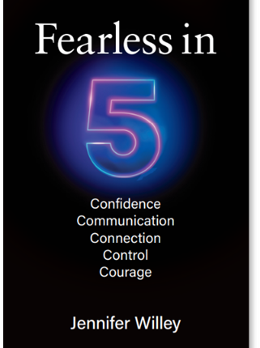

BUILD YOUR PERSONAL BOARD OF DIRECTORSTM
 | Peer Mentors Your trusted ‘truthteller’ (at a similar level) who helps strategize on how to be more effective or successful | Mentor Someone you trust who can provide guidance + coaching. Typically, a senior, seasoned colleague. | Mentee Junior, high-potential connection you can learn from while ‘giving back’ as their mentor | Sponsor Advocates for you when you’re not in the room. Leader with power and influence.
Current Board Member(s)
Potential Board Members
Skill You Want to Develop |  |  |  | Sponsors only need to know your strengths and goals—they are not someone who necessarily helps you develop skills.
Skills + Strengths You Can Share

Slide 2
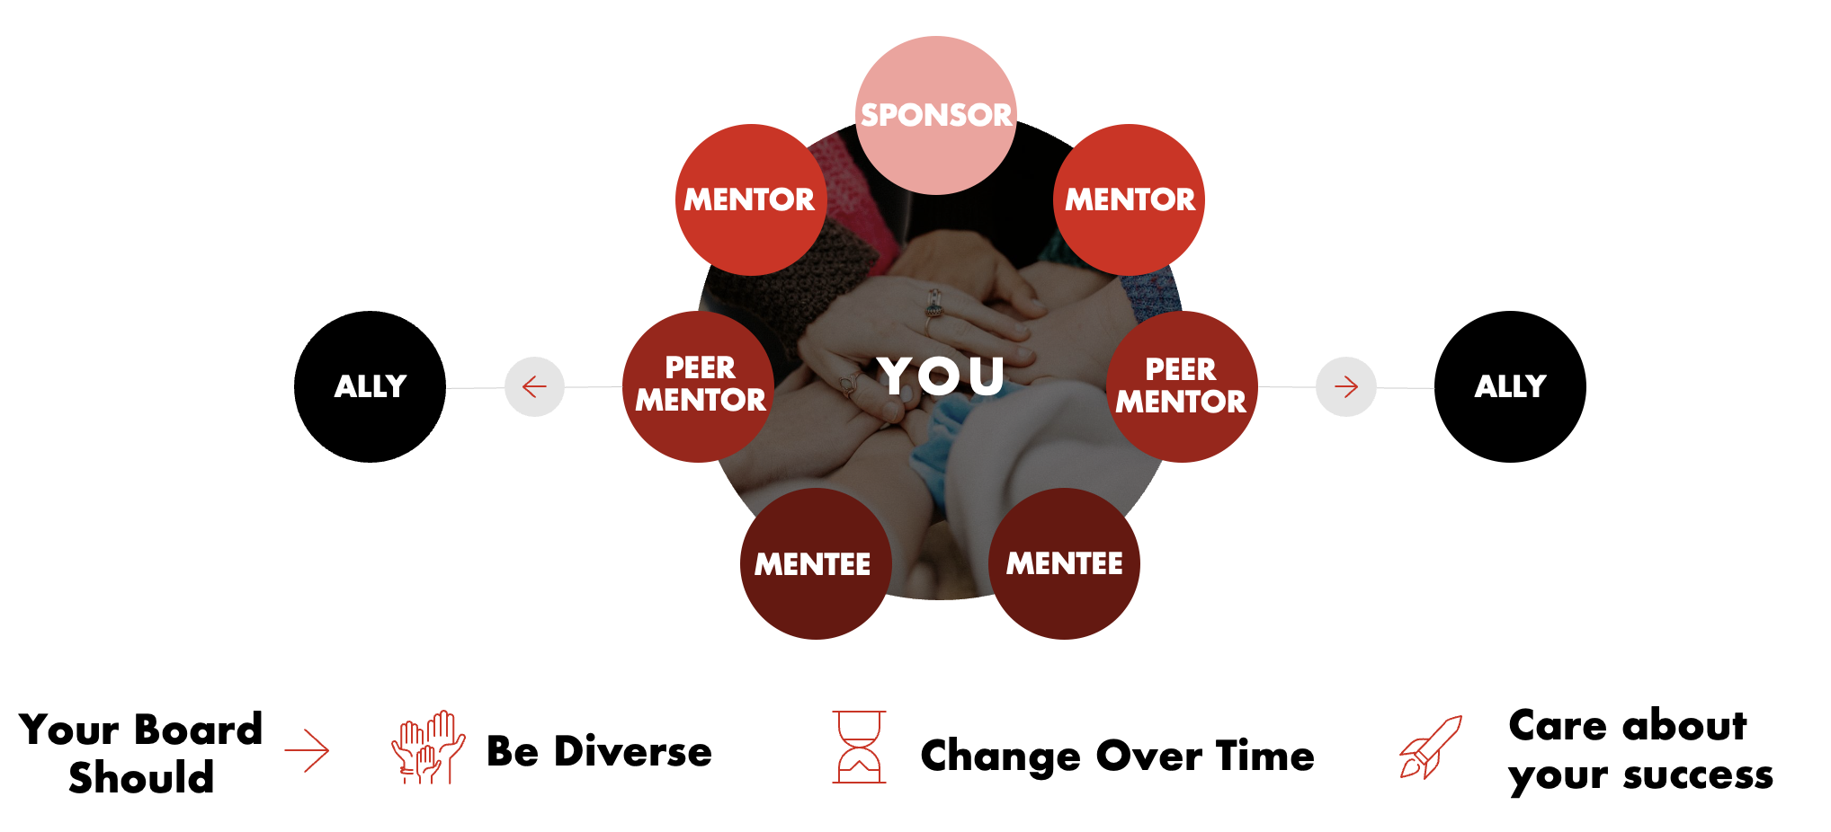
WHAT STEPS WILL YOU TAKE
TO BUILD YOUR
‘PERSONAL BOARD OF DIRECTORS?’
Want to be more fearless at work and in life?
Learn more at Fearless-in-5.com and at Wet-Cement.com.
Contact Fearless in 5 Author and Wet Cement Founder Jennifer Willey at info@fearless-in-5.com.
© Wet Cement 2026
Notes:
This is what a Star Board looks like.

